Slide 1
Project Floors
Flooring that doesn’t cost the EARTH
Planet Positive
www.projectfloors.co.nz

Slide 2
Introducing…
Equivalent Greenhouse Gases

Slide 3
Carbon neutral is not enough for us
Carbon neutral is not enough for us
We’ve gone one step further. . .
Carbon Negative
Turning Waste into Matter

Slide 5
2025
LCA global production of nylon 6 @1.1kg. CO2

Slide 6
70% Less CO2 Over Virgin Nylon 6
How much is 70%? - using Thrive matter saves more than 5 kg per m²of carpet tile.
Over 99.9% of production waste is captured and reintegrated into the manufacturing process
Industry-leading low product-to-CO2 footprint of 1.1kg CO2 eq, compared to 9.6kg CO2 eq for virgin materials.
This already low number goes below zero by partnering with Carbonfund.org

Slide 7
Lowest Carbon + Positive Benefit
Carpets made with Thrive® matter offset CO2 emissions nearly three times more than carpets made with virgin SD nylon.
Thrive® matter raises the stakes with a fiber that has a net positive climate impact.
Since 2021, we have extracted and saved 3.6 billion kgs of landfill and turned it into Thrive Matter!
99.9% Recyclable - means Thrive fits seamlessly into a closed-loop system, reducing waste and contributing to a more sustainable future.

Slide 11
Carbon Projects
Partnering with carbonfund.org supports two projects that are both certified with internationally recognised standards and have passed strict criteria.
Notes:
By incorporating Thrive fiber into your Project Floors’ carpet tile, you have the opportunity to offer your clients 'Offset Certificates'. These certificates, issued by Universal Fibers and verified by Carbonfund, not only acknowledge your brand but also provide official certification for your project's environmental impact. Also demonstrating your commitment to sustainability and provides tangible recognition for your eco-conscious efforts.
Two of the projects supporting currently are as follows:

Slide 12
Soma III Wind Farm Project
50 wind turbines with a total installed capacity of 100 megawatts (MW).
Generate approx. 280 Gigawatt hours (GWh) per annum.
Estimated to reduce approximately 167,000 metric tons of carbon dioxide (tCO2eq) per year emission reductions.
Notes:
The Soma III Wind Farm Project is a large-scale wind project in Savastepe District of Balikesir Province and Soma District of Manisa Province in Turkey.
The Soma III Wind Farm Project involves the installation of 50 wind turbines with a total installed capacity of 100 MW. The proposed project activity is estimated to generate approximately 280 GWh per annum.
The electricity generated will be delivered to the national grid at via high voltage transmission line and the proposed project activity is estimated to reduce approximately 167,000 tCO2eq/year emission reductions.
Furthermore, the project has four certified sustainable development goal (SDG) impacts for: no poverty (SDG #1); clean water and sanitation (SDG #6); affordable and clean energy (SDG #7); and climate action (SDG #13).

Slide 13
The Russas Valparaiso Projects
Near city of Cruzeiro do Sul in the State of Acre, Brazil
Forest Conservation / Avoided Deforestation
70,072 hectares (173,152 acres)
Verified Carbon Standard (VCS)
Reduce carbon dioxide emissions
Mitigate climate change
Conserve habitat for endangered and threatened species
Notes:
In the world’s largest rainforest, the Russas and Valparaiso Projects are forest conservation and community development projects which involve numerous local and international partners that will protect nearly 175,000 acres from slash-and-burn forest clearing and prevent millions of tonnes of greenhouse gas emissions. These projects will also provide essential ecosystem services such as: erosion control along the Valparaiso River; water cycling, filtration and storage; nutrient recycling; and habitat for thousands of native Amazonian animal and plant species, including short eared dogs, jaguars, and giant anteaters.
Avoided deforestation projects are critical because about 20 percent of global warming is attributed to deforestation, because deforestation leads to the release of carbon stored in trees. Moreover, deforestation reduces the Earth’s capacity to absorb carbon dioxide and fallen trees decompose and release methane, a heat-trapping gas about 23 times more potent than CO2.

Slide 14
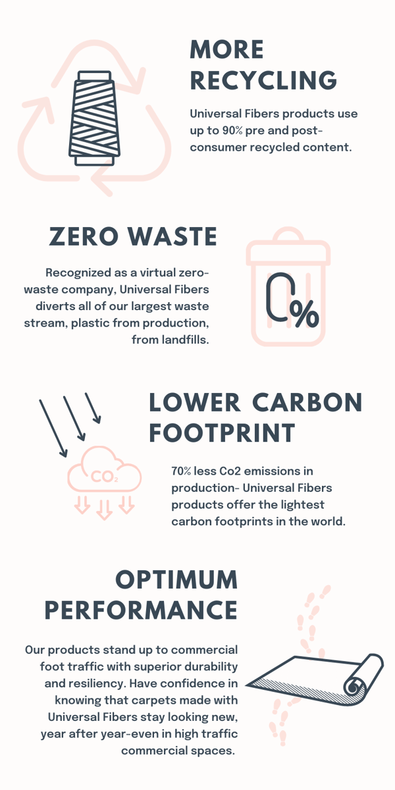
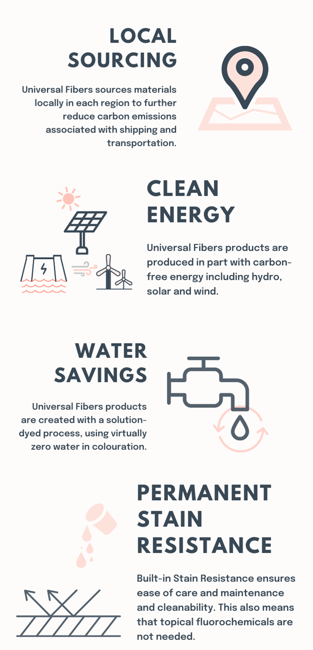
What makes our products and
processes different?

Slide 16
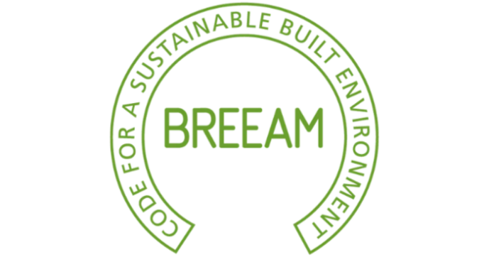
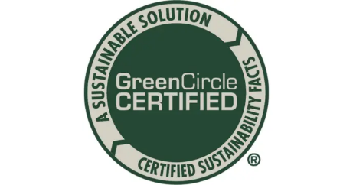
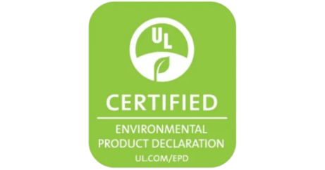
3rd Party Certification
Project Floors
Notes:
As we wrap up today, I want to leave you with this thought: Let's make your project thrive. Together, we have the power to create spaces that not only inspire but also contribute to a more sustainable future.
Before we conclude, I'd like to open the floor for any questions or discussions. Are there any upcoming projects that your team has in mind where Thrive Matter fiber could play a pivotal role in elevating both sustainability and design?

